Slide 1
Use Case Documents
By Paul Darr

Slide 2
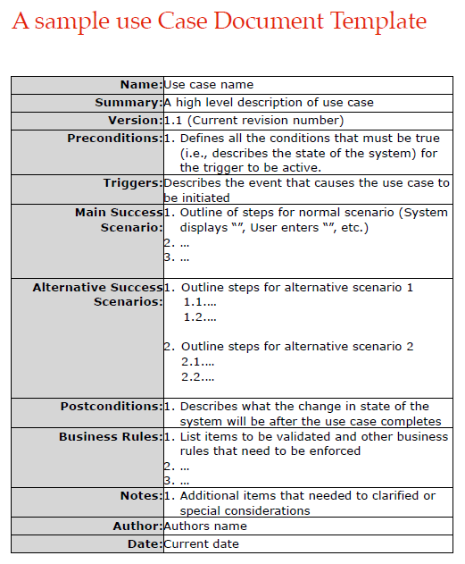
Sample Use Case Document

Slide 3
Resources:
Template available at:
https://github.com/yenrab/doing_more_with_java/blob/master/design_example_docs/track_360_use_case_documents.pdf
Doing More With Java PG. 15 Example
Web resource:
http://mohamedelgendy.com/blog/how-to-write-a-use-case.html

Slide 4

Name, Summary, Version
Assign a unique name to your use case preferably describing the functionality you want to present (like food order, order processing or ATM machine).
Summary is a high level description of use case.
Version is the current version number.

Slide 5
Pre-conditions and Triggers
Pre-conditions are the conditions that must be met before this use case can start. Such as, the user has been granted authority to access the system or prices must exist for the products being sold.
Triggers describe the event that causes the use case to be initiated.

Slide 6
Main & Alternative Success Scenarios
Outline the steps for normal scenario
Outline the steps for alternative scenario

Slide 7
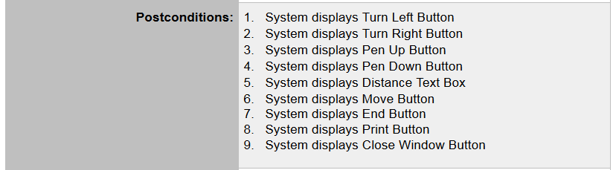
Postconditions
This part is exactly how it sounds. What should happen when the use case ends?

Slide 8
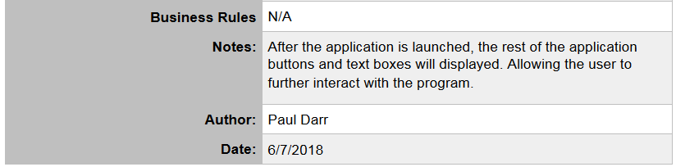
Business Rules, Notes, Author, Date
Notes are the additional items that need to be clarified or special conditions.

